Slide 1

Evaluation of Personalized Summarization w.r.t. Temporal Variance
Presented By: Darsh Rank (201901247)
Project Guide: Prof. Sourish Dasgupta

Slide 2
Outline
Evaluation of degree of personalization in Summarizers
Problem statement
State-of-the-art summarization evaluation (accuracy-centric)
Accuracy-centric measures vs. Personalization-centric measure
Designing evaluation measure
e-DINS w.r.t temporal variance
Experimental Setup
Dataset
Computing e-D-INS using human gold reference summaries (from PENS test dataset)
Degree of personalization of SOTA personalized summarizers
Reliability of e-DINS as a degree of personalization measure
Future work : Work in progress
Notes:
Things that we are focusing on

Slide 3
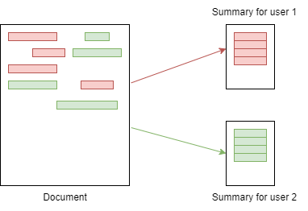
Why personalization?
Is reader interested in the information presented in a summary?
Personalized summarization considers user’s attention/ interest to generate summary [3].
Notes:
salient = imp info
Static summary

Slide 4
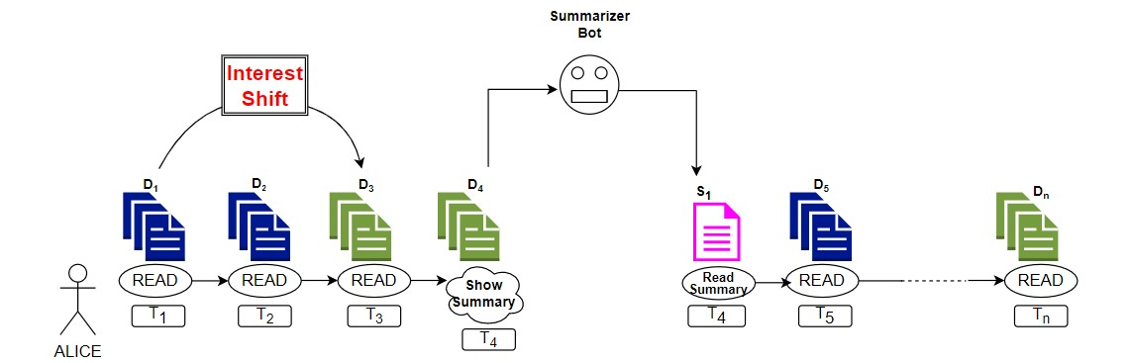
What is Personalization w.r.t Temporal Variance?
Summarizer should adapt to change in user’s interest shift to different topics
Have to be sensitive to drift in attention of user over time
Maximize “freshness” of content in summaries
Notes:
Maximizing novelty : we arent interested in same info again next time, right?
See left img: generic one…
right img: different angle :well i wasnt expecting count i was news update of recent issues which is in china … observe novelty in each or right news

Slide 5
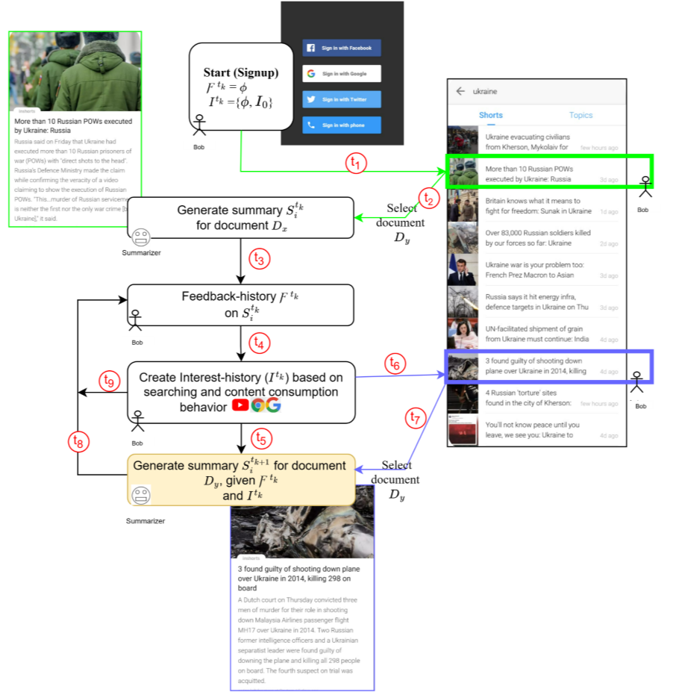
Personalized Summarization
To what extent model is personalized w.r.t drift in user’s interests? - so far, no measure

Slide 6
Evaluation of degree of personalization: Motivation

Slide 7
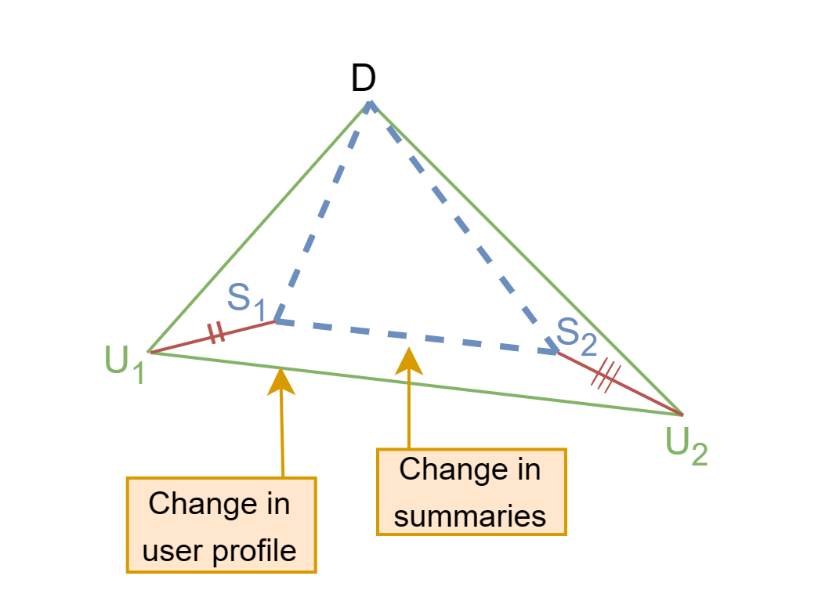
Problem Statement
Degree of personalization indicates how well model adapts to the user's preferences while generating a summary for the user.
In order to accurately measure it, changes to both user profiles and summaries must be considered.
Notes:
Things that we are focusing on

Slide 8
State-of-the-art summarization evaluation
 |  | Manual Evaluation | Automated Evaluation
 |  |  | Reference-based | Reference-free
Accuracy |  | Factoid (2003) Pyramid (2004) SEE (2003) | Cosine similarity (1989) BLUE (2002) ROUGE (2004) Unit overlap (2002) Latent-based (2009) Semi-automated pyramid (2018) Automated pyramid (2017) | KL divergence (1959) Jensen–Shannon divergence (1991) FRESA (2013) SummTriver (2018) Summary likelihood (2013) SUPERT (2020)
Quality |  | DUC 2005 readability TAC 2008 readability | Sum-QE(2019)
Degree of personalization | w.r.t. Temporal Variance | ??
Different evaluation metrics for accuracy and quality [1]
Notes:
Things that we are focusing on

Slide 9
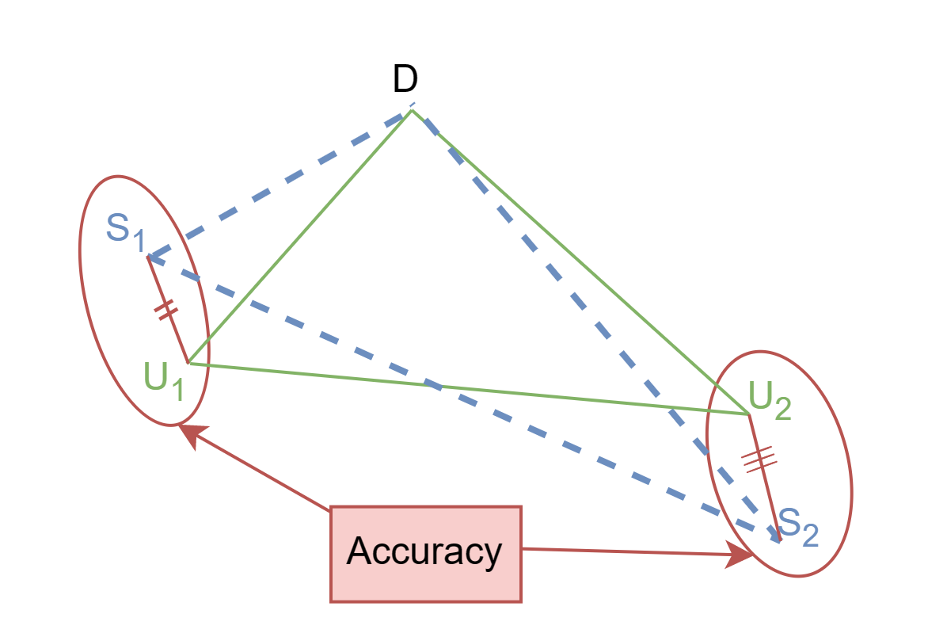
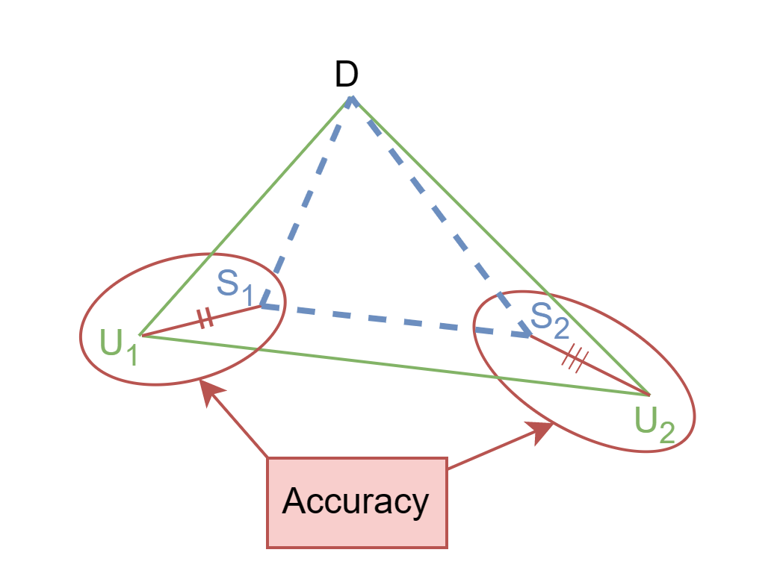
Accuracy-centric measure vs. Personalization-centric measure
Accuracy-centric measure : Difference between user written and model generated summary
Personalization-centric measure : Proportional differential in model-generated summary and user profile distances
(a) Accuracy is high, personalization is low
(b) Accuracy is high, personalization is high
Notes:
Things that we are focusing on: Difference in model generated summary proportional to difference in user profile (w.r.t. document)

Slide 10
Designing evaluation measure
Effective Degree of Insensitivity (w.r.t temporal variance)

Slide 11
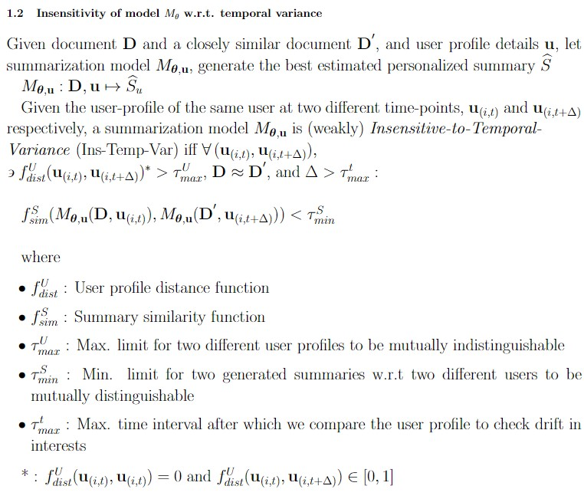
What is Insensitivity w.r.t Temporal Variance?
Notes:
Things that we are focusing on

Slide 12
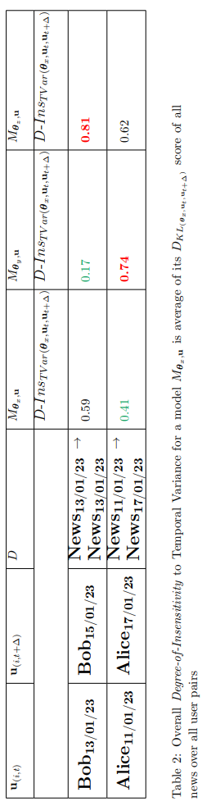
Degree of Insensitivity (D-INS) as a viable measure
Notes:
Things that we are focusing on

Slide 13
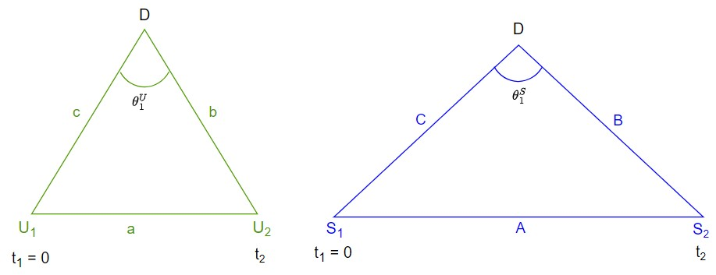
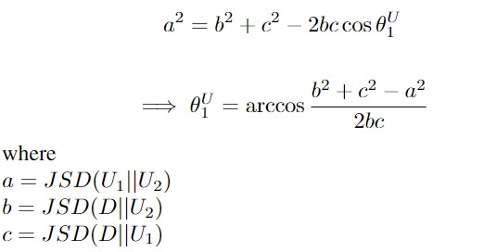
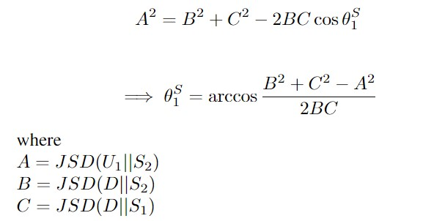
Angle of Deviation : Formulation
Angle of Deviation represents the shift in the user profile and model generated summary post some time interval.

Slide 14
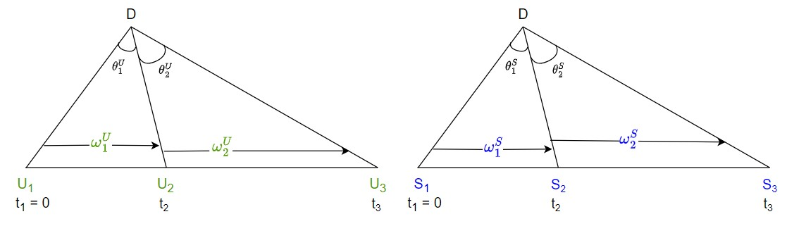
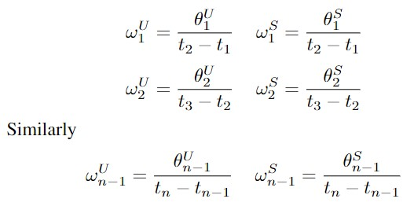
Angular Speed : Formulation
Angular Speed measures the rate at which the user profile changes overtime and the speed at which the model generated summaries change overtime.

Slide 15
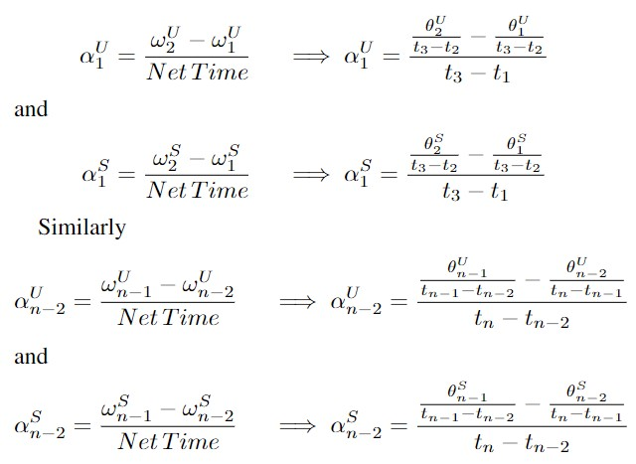
Rate of change of Angular Speed: Formulation
The rate of change of the angular speed helps us measure the rate at which the summarizer is able to change its model generated summaries to keep up with the change in user profile.

Slide 16
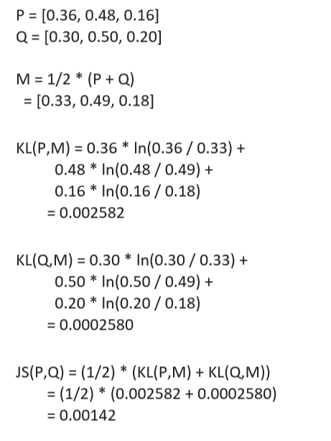


D-INS w.r.t temporal variance (D-INS_{TV}): Formulation
Jensen–Shannon divergence used to find distance between the distributions of two summaries.
Notes:
Things that we are focusing on

Slide 17
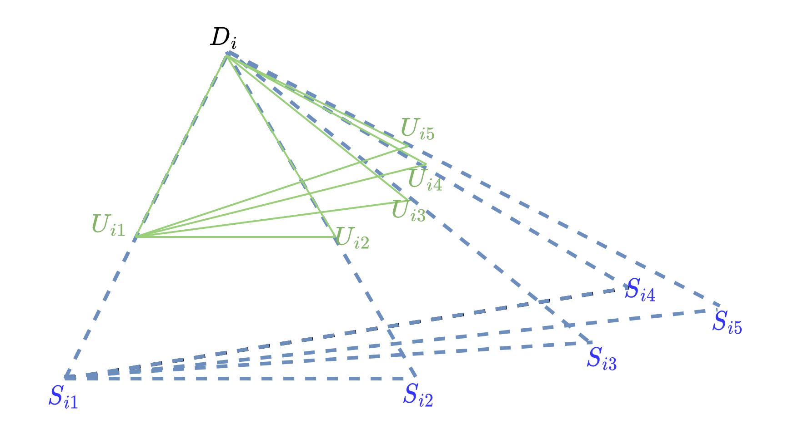
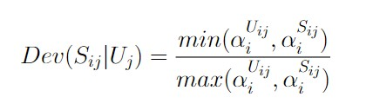
Deviation : Formulation
Deviation Dev(S_{i}) calculates proportional difference of rate of change of angular speed of summarizer ɑ^{Uij}_{i} (U_{ij} : i^{th} summary of j^{th} user) and user profile ɑ^{Sij}_{i} (S_{ij} :i.e. corresponding i^{th} model generated summary of the j^{th} user).

Slide 18
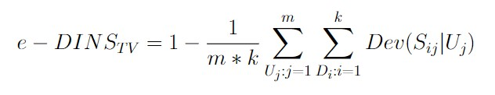
e-DINS w.r.t temporal variance(e-DINS_{TV}): Formulation
Effective Degree of Insensitivity w.r.t temporal variance e-DINS_{TV} evaluates performance of model based on how much summary deviates as per user profile at a specific time instant.
e-DINS_{TV} is high when summary pair doesn’t deviate as per updated user profile
This indicates model is highly insensitive i.e. bad in capturing personalization
Notes:
Things that we are focusing on

Slide 19
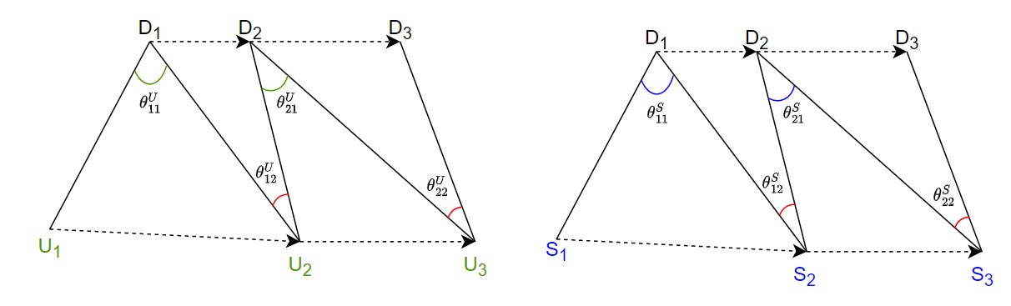
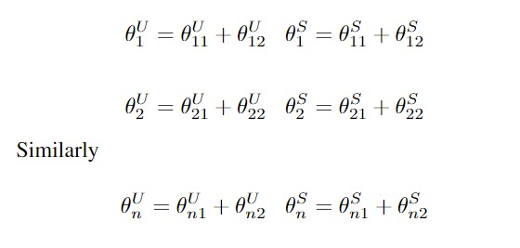
Shift in Source Document: Formulation
The net angle of deviation changes when the source document changes.
Shift in source document is more practical scenario. Eg: Tweet streams

Slide 20
Experimental Setup

Slide 21
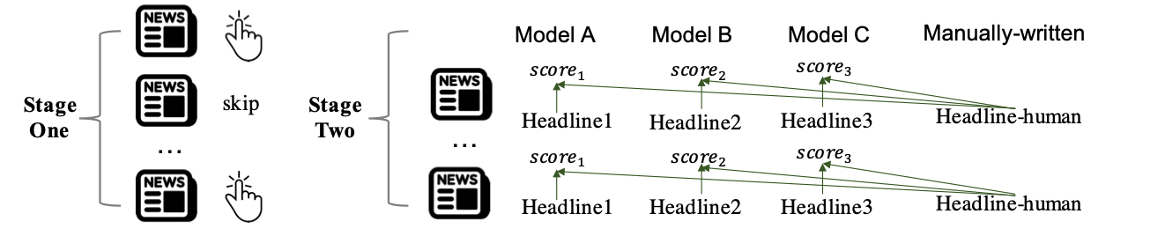
Dataset: PENS (Personalized News headlineS) (Test set)
Test set includes 3840 news article & prepared in 2 stages
1st: Each person browses 1,000 news headlines and marks at least 50 pieces he is interested in
2nd: Write their preferred headlines for 200 different articles, without knowing original news title
these news articles are excluded from the 1st stage
For each news, prefered headlines is written by 4 people on average
Notes:
1st: Each person browses 1,000 news headlines and marks at least 50 pieces he is interested in.
2nd: Write their preferred headlines for different 200 articles , without knowing at original news title.
these news articles are excluded from the 1st stage
Redundantly assign them to make sure each news is seen by 4 people on average.

Slide 22
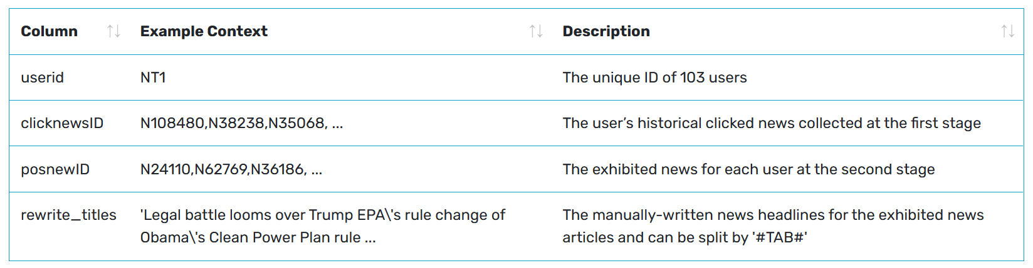
Dataset: PENS (Personalized News headlineS) (Test set)
Notes:
1st: Each person browses 1,000 news headlines and marks at least 50 pieces he is interested in.
2nd: Write their preferred headlines for different 200 articles , without knowing at original news title.
these news articles are excluded from the 1st stage
Redundantly assign them to make sure each news is seen by 4 people on average.

Slide 23
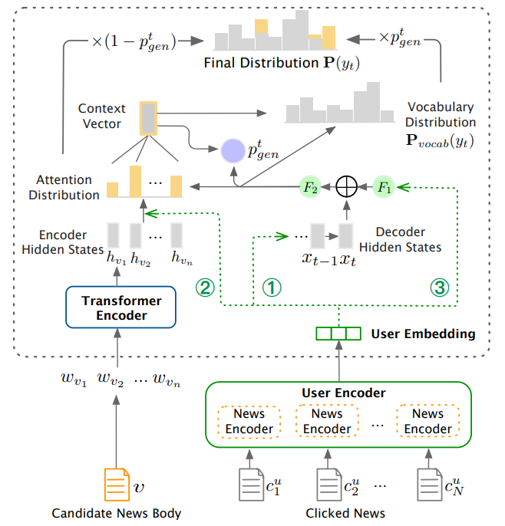
PENS Personalized Summarization model [ACL; 2021]
Three ways to inject user embedding
To initialize decoder’s hidden state of the headline generator
To personalize attentive values on words in news body
To affect choice between generation and copying
Training process
Pointer-Generator Network trained on actual headline
Further, policy model optimized on reward of generated headline
reward considers degree of personalization, fluency and factualness.
Framework of personalized news headline generation [3]

Slide 24
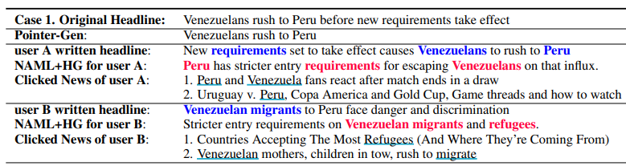
Example of personalized summary (headline) generation
Underlined words and colored words represent the correlated words in the manually-written headlines, clicked news, and the generated headlines, respectively.

Slide 25
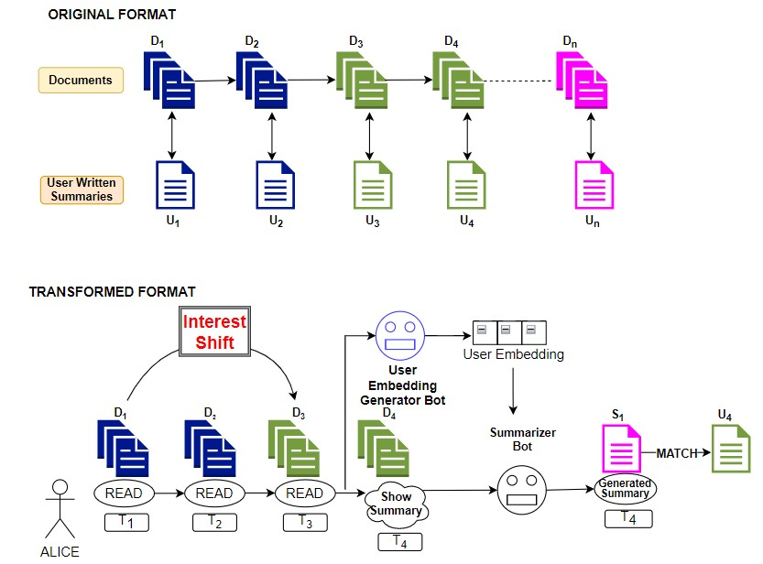
Using the PENS test data to Evaluate Temporal Variance

Slide 26
Degree of personalization of SOTA personalized summarizers (PENS models)

Slide 27
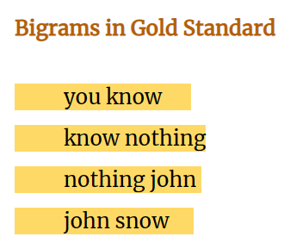
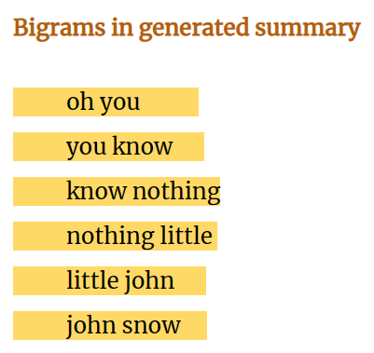
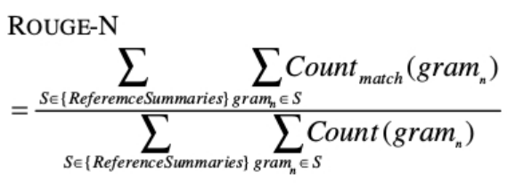

ROUGE : Recall-Oriented Understudy for Gisting Evaluation
Notes:
Things that we are focusing on

Slide 28
Personalization vs. Accuracy w.r.t user profiles models
User embedding used in PENS | User embedding injection type | e-DINS_{TV} | ROUGE 1 | ROUGE 2 | ROUGE L
NAML | 1 | 0.5337 | 27.49 | 10.14 | 21.62
NRMS | 1 | 0.5347 | 26.15 | 9.37 | 21.03
EBNR | 1 | 0.5329 | 25.13 | 9.03 | 20.73
EBNR | 2 | 0.5359 | 25.49 | 9.14 | 20.82
NT: ROUGE scores are w.r.t user-written extreme summaries (i.e. headlines) in PENS dataset
Notes:
26.15, 9.37, 21.03

Slide 29
Reliability of e-DINS_{TV} as a degree of personalization measure

Slide 30
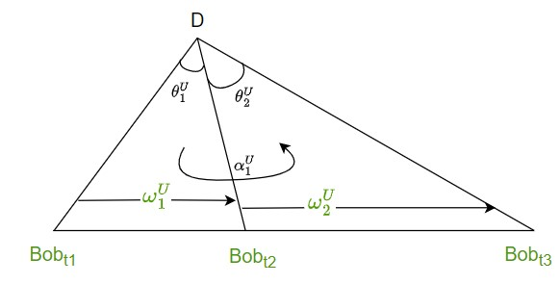
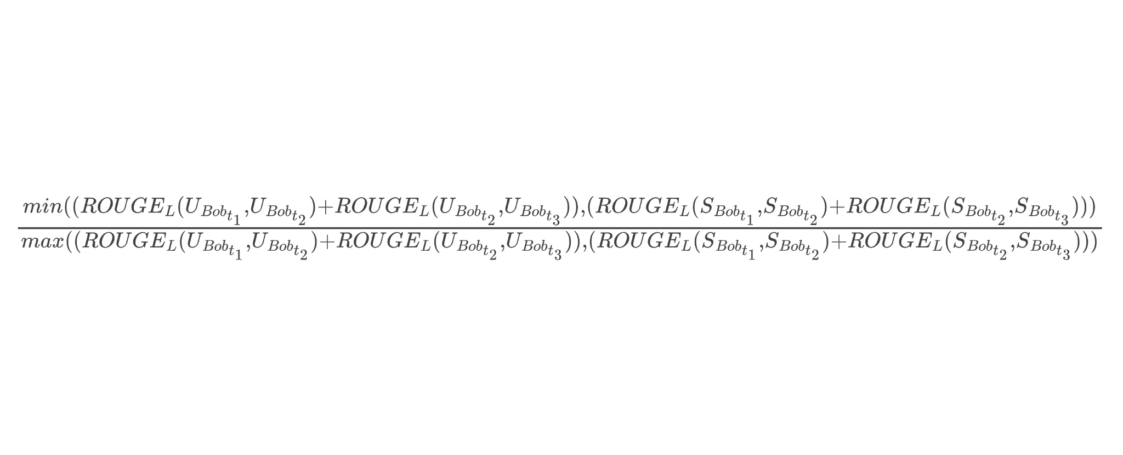
Indirect e-DINS robustness evaluation (using ROUGE L)
Ground Truth
Proportional Difference w.r.t RougeL
Deviation | Dev(S_{Bob} |Bob)
ROUGE score is a widely used metric with a high correlation with human judgment compared to other measures of accuracy [2]

Slide 31
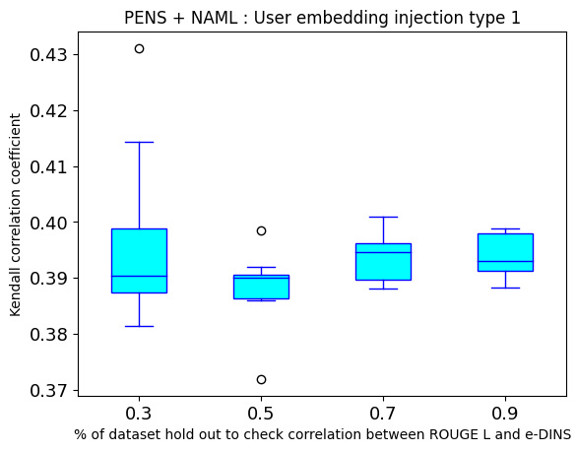
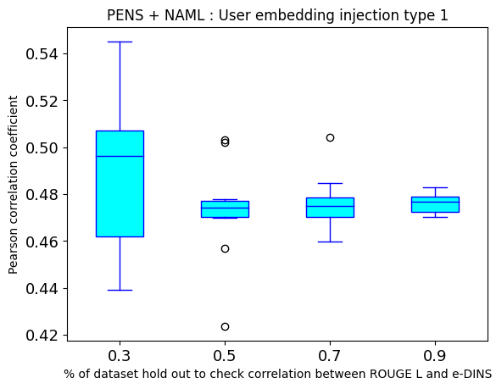
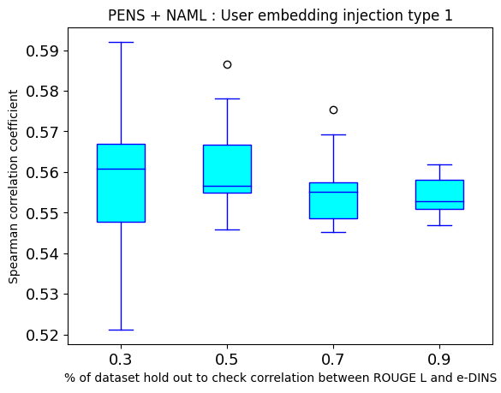
Reliability of e-DINS_{TV} as a degree of personalization measure
Notes:
26.15, 9.37, 21.03

Slide 32
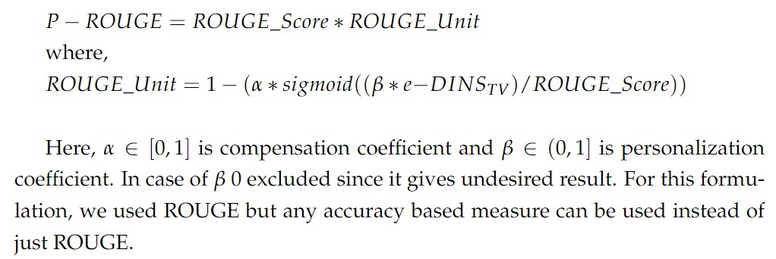
Personalized ROUGE (P-ROUGE)

Slide 33
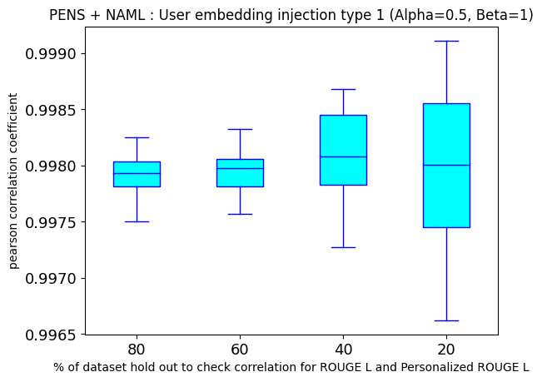
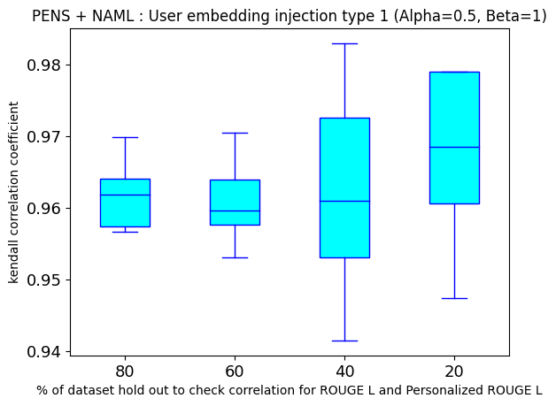
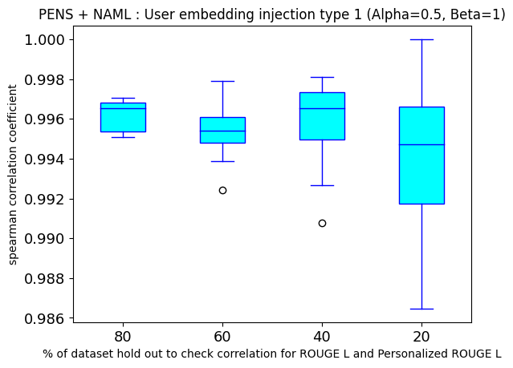
Personalized ROUGE

Slide 34
Conclusion: Work-in-progress

Slide 35
Future work (Order-wise)
Evaluating ChatGPT-styled models’ degree of personalization w.r.t temporal variance.
Tweaking the dataset to simulate real time progressive temporal variance scenario.
Trying out different datasets with the time stamp data.
Notes:
Things that we are focusing on

Slide 36
Ref
1. Daniel O et.al.; A comprehensive review of automatic text summarization techniques: method, data, evaluation and coding; arXiv; 2023
2. Tianyi Zhang et. al.; Benchmarking Large Language Models for News Summarization; arXiv; 2023
3. Xiang Ao et. al.; PENS: A Dataset and Generic Framework for Personalized News Headline Generation; IJCNLP; 2021
4. Mike Lewis et. al.; BART: Denoising Sequence-to-Sequence Pre-training for Natural Language Generation, Translation, and Comprehension, Association for Computational Linguistics, 2019

Slide 37
Thank you

